Slide 1
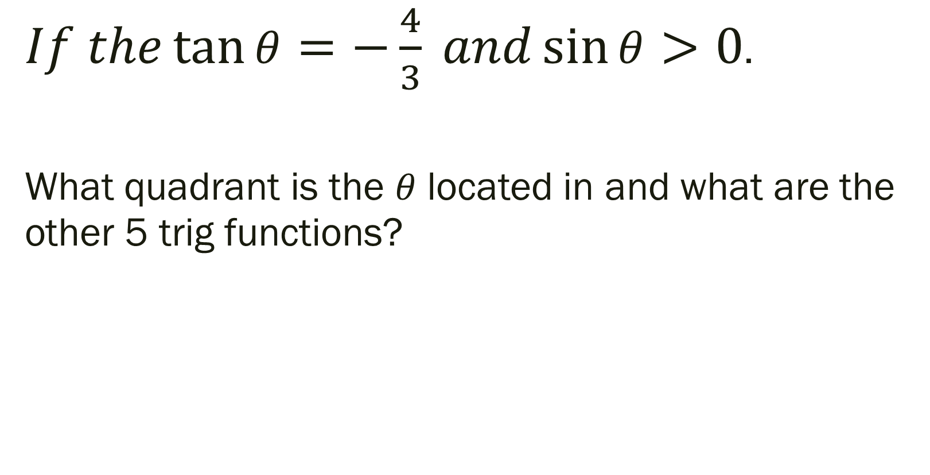
Bell Work: Simplify
$If the\tan{θ}=−\frac{4}{3} and\sin{θ}>0$.
What quadrant is the $θ$ located in and what are the other 5 trig functions?

Slide 2
For Next Time
Page 306 #1, 5-6, 30-31, 37-40, 45, 47, 57, 63-64, 67, 71
Get a Head Start…
Page 316 #9, 11, 13, 19-24, 37-44, 45-51 (odd), 69, 71, 97

Slide 3
Pre-calc trig
Day 35

Slide 4
4.4 Trig Functions of Any Angle
Objective: Evaluate trig functions of any angles

Slide 5
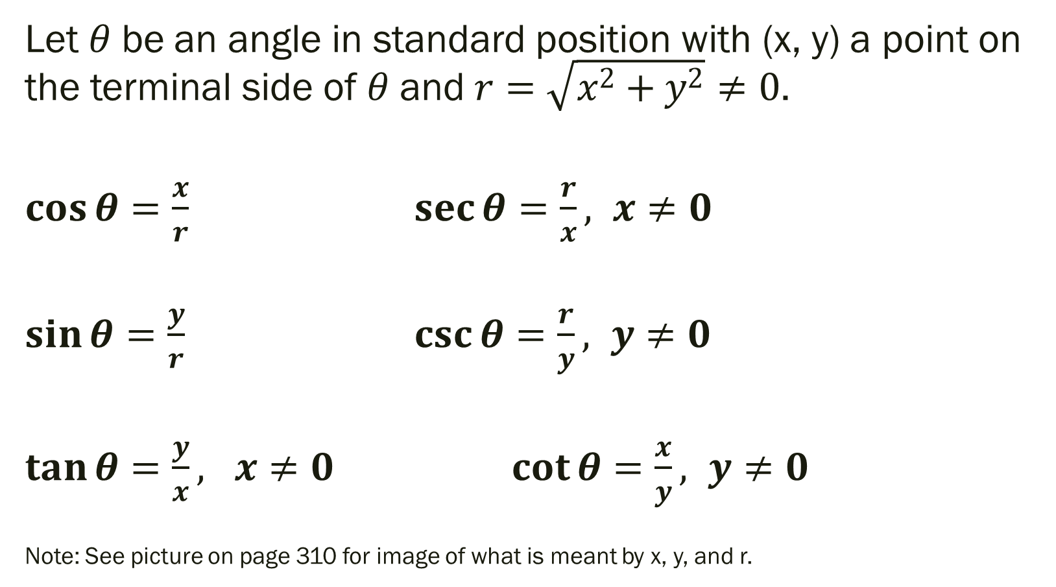
Definitions of Trigonometric Functions of Any Angle
Let $θ$ be an angle in standard position with (x, y) a point on the terminal side of $θ$ and $r=\sqrt{x^{2}+y^{2}}≠0$.
$\cos{θ=\frac{x}{r}}$ $\sec{θ=\frac{r}{x}, x≠0}$
$\sin{θ=\frac{y}{r}}$ $\csc{θ=\frac{r}{y}, y≠0}$
$\tan{θ=\frac{y}{x}, x≠0}$ $\cot{θ=\frac{x}{y}}, y≠0$
Note: See picture on page 310 for image of what is meant by x, y, and r.

Slide 6
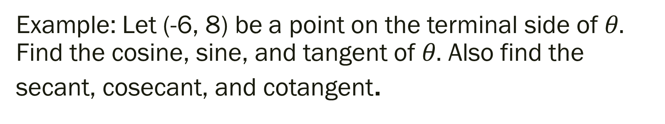
Example: Let (-6, 8) be a point on the terminal side of $θ.$ Find the cosine, sine, and tangent of $θ.$ Also find the secant, cosecant, and cotangent.

Slide 7
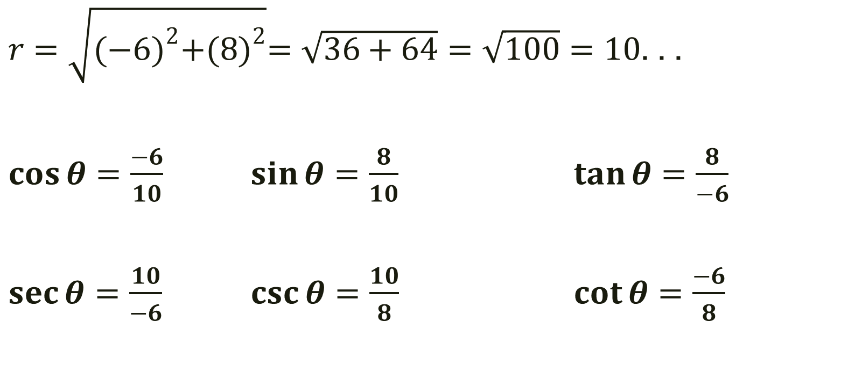
Example: Let (-6, 8) be a point on the terminal side of $θ.$ Find the cosine, sine, and tangent of $θ.$ Also find the secant, cosecant, and cotangent.
$r=\sqrt{{(−6)}^{2}+{(8)}^{2}}=\sqrt{36+64}=\sqrt{100}=10$. . .
$\cos{θ=\frac{−6}{10}}$ $\sin{θ=\frac{8}{10}}$ $\tan{θ=\frac{8}{−6}}$
$\sec{θ=\frac{10}{−6}}$ $\csc{θ=\frac{10}{8}}$ $\cot{θ=\frac{−6}{8}}$

Slide 8

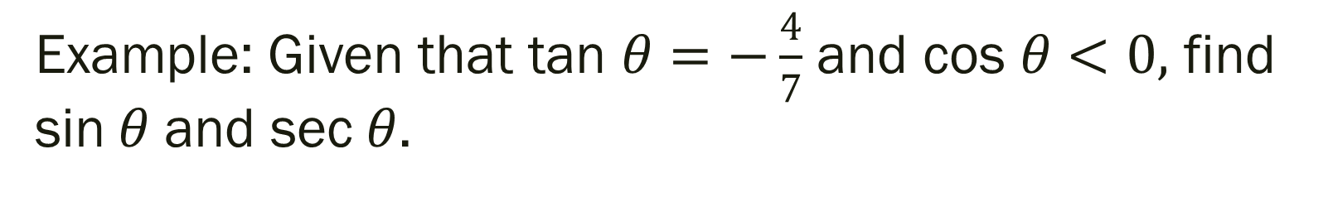
Example: Given that tan $θ=−\frac{4}{7}$ and cos $θ<0,$ find sin$θ$ and sec$θ$.
-- Note that $θ$ is in Quadrant II because that is the only quadrant in which tangent is negative and cos is negative.

Slide 9
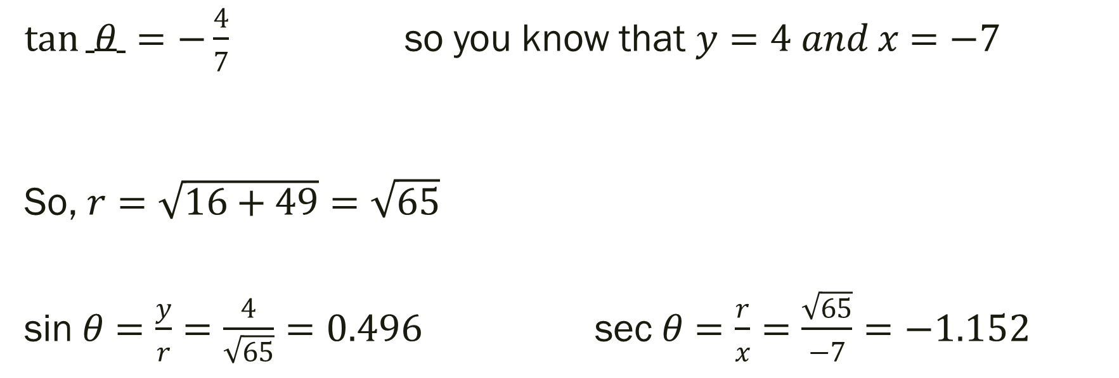
Example: Given that tan $θ=−\frac{4}{7}$ and cos $θ<0,$ find sin$θ$ and sec$θ$.
$\tan{ θ =−\frac{4}{7}}$ so you know that $y=4 and x=−7$
So, $r=\sqrt{16+49}=\sqrt{65}$
sin$θ=\frac{y}{r}=\frac{4}{\sqrt{65}}=0.496$ sec$θ=\frac{r}{x}=\frac{\sqrt{65}}{−7}=−1.152$

Slide 10
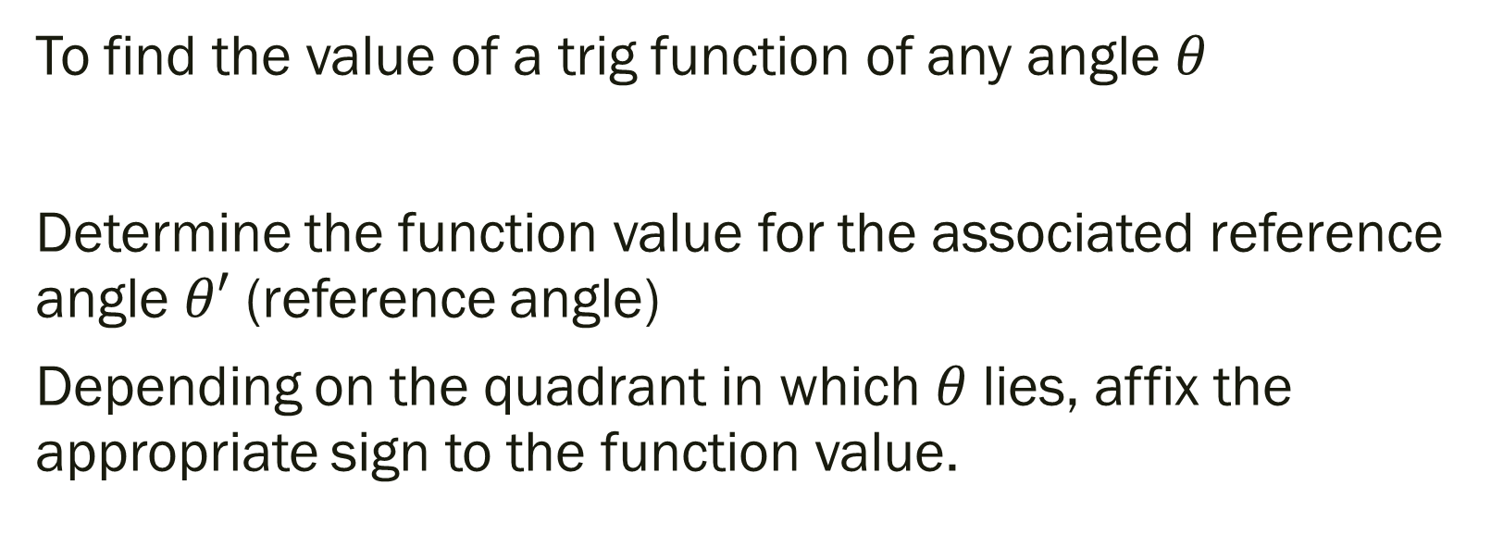
Evaluating Trig Functions of Any Angle
To find the value of a trig function of any angle $θ$
Determine the function value for the associated reference angle $θ′$ (reference angle)
Depending on the quadrant in which $θ$ lies, affix the appropriate sign to the function value.

Slide 11
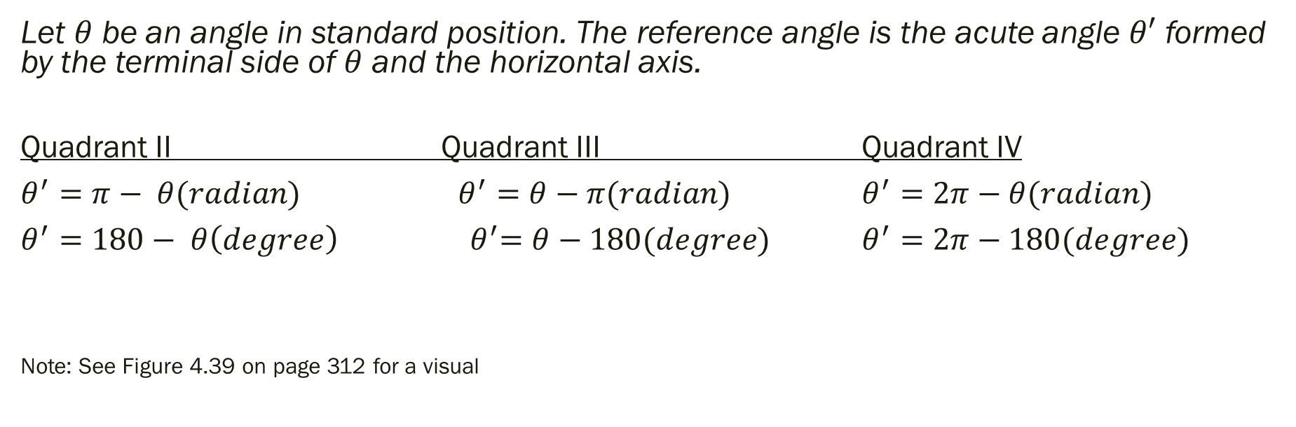
Reference Angles
Let $θ$ be an angle in standard position. The reference angle is the acute angle $θ′$ formed by the terminal side of $θ$ and the horizontal axis.
Quadrant II Quadrant III Quadrant IV
$θ^{′}=π− θ(radian)$ $θ^{′}=θ−π(radian)$ $θ^{′}=2π−θ(radian)$
$θ^{′}=180− θ\left(degree\right)$ ${ θ}^{′}=θ−180(degree)$ $θ^{′}=2π−180(degree)$
Note: See Figure 4.39 on page 312 for a visual

Slide 12

Example
Find the reference angle $θ′$
$1.) θ=290°$
$2.) θ=3.4$

Slide 13
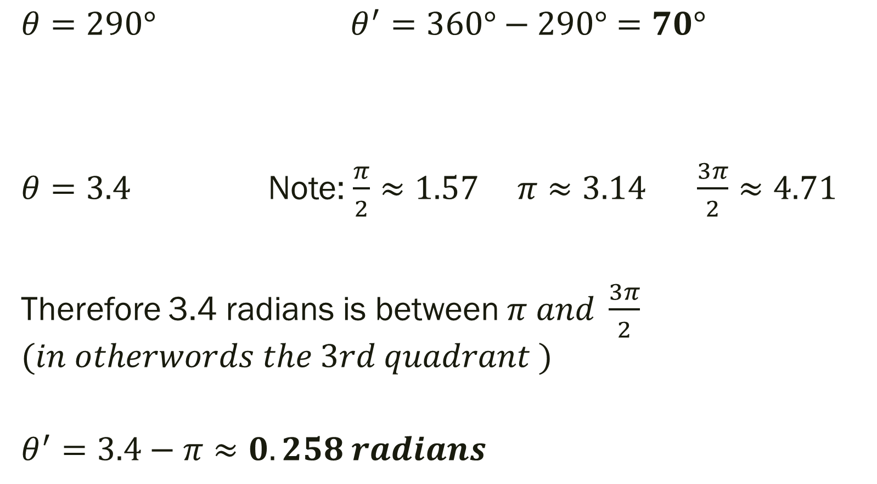
Example
$θ=290°$ $θ^{′}=360°−290°=70°$
$θ=3.4$ Note: $\frac{π}{2}≈1.57 π≈3.14 \frac{3π}{2}≈4.71$
Therefore 3.4 radians is between $π and \frac{3π}{2}$ $$(in otherwords the 3rd quadrant )$$
$$θ^{′}=3.4−π≈0.258 radians$$

Slide 14
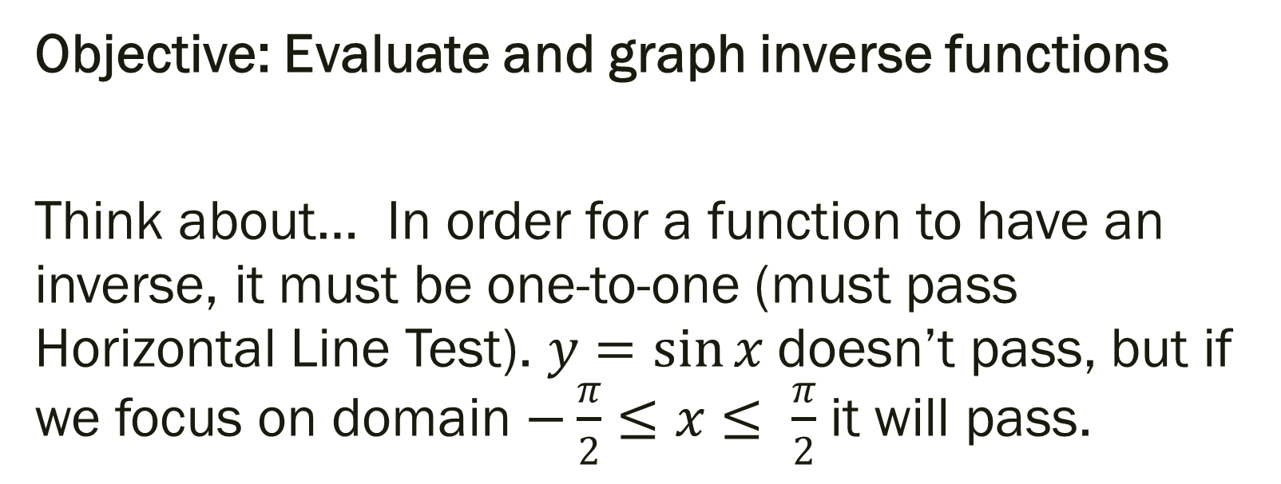
4.7 Inverse Trig Functions
Objective: Evaluate and graph inverse functions
Think about… In order for a function to have an inverse, it must be one-to-one (must pass Horizontal Line Test). $y=\sin{x}$ doesn’t pass, but if we focus on domain $−\frac{π}{2}≤x≤ \frac{π}{2}$ it will pass.

Slide 15
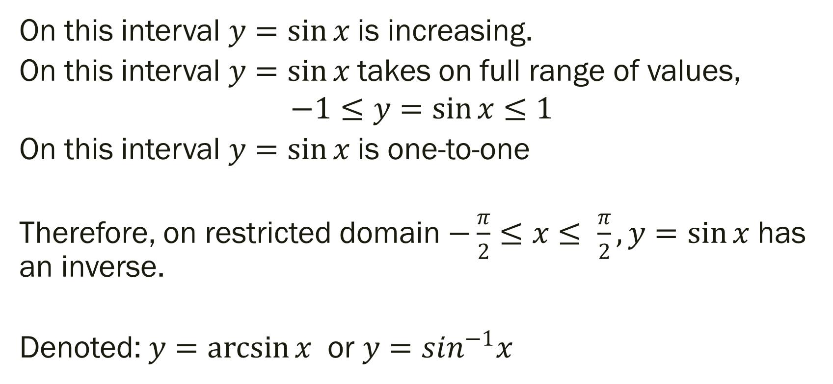
Inverse of Trig Functions (explained with sine)
On this interval $y=\sin{x}$ is increasing.
On this interval $y=\sin{x}$ takes on full range of values,
$$−1≤y=\sin{x}≤1$$
On this interval $y=\sin{x}$ is one-to-one
Therefore, on restricted domain $−\frac{π}{2}≤x≤ \frac{π}{2}, y=\sin{x}$ has an inverse.
Denoted: $y=\arcsin{x}$ or $y=sin^{−1}x$

Slide 16
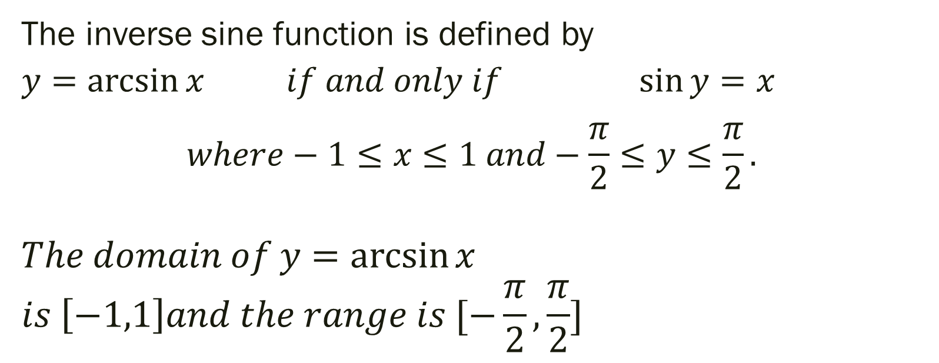
Definitions of Inverse Sine Function
The inverse sine function is defined by
$y=\arcsin{x}$ $if and only if$ $\sin{y}=x$ $$where−1≤x≤1 and−\frac{π}{2}≤y≤\frac{π}{2}.$$
$$The domain of y=\arcsin{x}$$
$$is \left[−1,1\right]and the range is [−\frac{π}{2}, \frac{π}{2}]$$

Slide 17

Examples: If possible, find the exact value.
$1.) arcsin\left(\frac{\sqrt{3}}{2}\right)$
${2.) sin}^{−1}\left(\frac{−1}{2}\right)$
${3.) sin}^{−1}\left(5\right)$

Slide 18
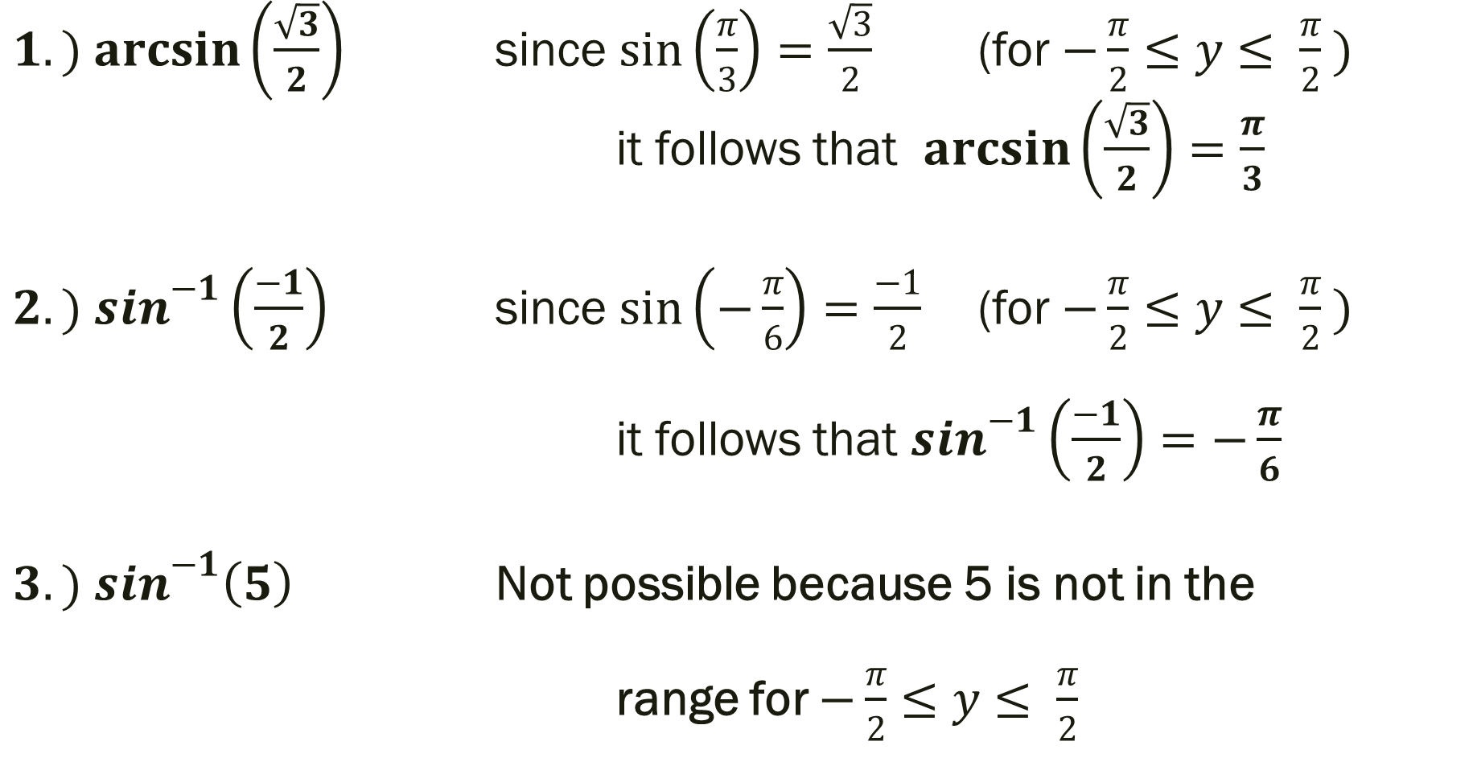
Examples: If possible, find the exact value.
$1.) arcsin\left(\frac{\sqrt{3}}{2}\right)$ since $\sin\left(\frac{π}{3}\right)=\frac{\sqrt{3}}{2}$ (for $−\frac{π}{2}≤y≤ \frac{π}{2} )$
it follows that $\arcsin\left(\frac{\sqrt{3}}{2}\right)=\frac{π}{3}$
${2.) sin}^{−1}\left(\frac{−1}{2}\right)$ since $\sin\left(−\frac{π}{6}\right)=\frac{−1}{2}$ (for $−\frac{π}{2}≤y≤ \frac{π}{2} )$
it follows that $\sin^{−1}\left(\frac{−1}{2}\right)=−\frac{π}{6}$
${3.) sin}^{−1}\left(5\right)$ Not possible because 5 is not in the
range for $−\frac{π}{2}≤y≤ \frac{π}{2}$

Slide 19
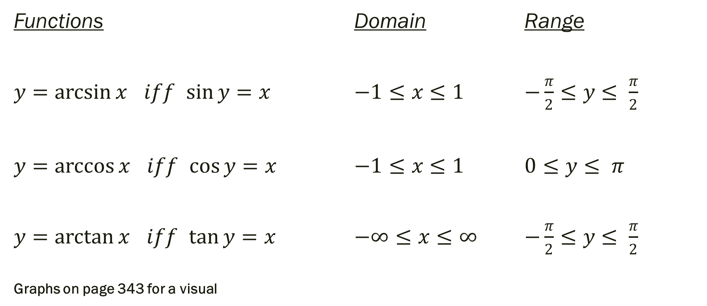
Definitions of the Inverse Trig Functions
Functions Domain Range
$y=\arcsin{x}$ $iff$ $\sin{y}=x$ $−1≤x≤1$ $−\frac{π}{2}≤y≤ \frac{π}{2}$
$y=\arccos{x}$ $iff$ $\cos{y}=x$ $−1≤x≤1$ $0≤y≤ π$
$y=\arctan{x}$ $iff$ $\tan{y}=x$ $−∞≤x≤∞$ $−\frac{π}{2}≤y≤ \frac{π}{2}$
Graphs on page 343 for a visual

Slide 20

Examples: If possible, find the exact value.
$1.) arccos\left(\frac{\sqrt{2}}{2}\right)$
${2.) cos}^{−1}\left(−1\right)$
${3.) tan}^{−1}\left(0\right)$

Slide 21
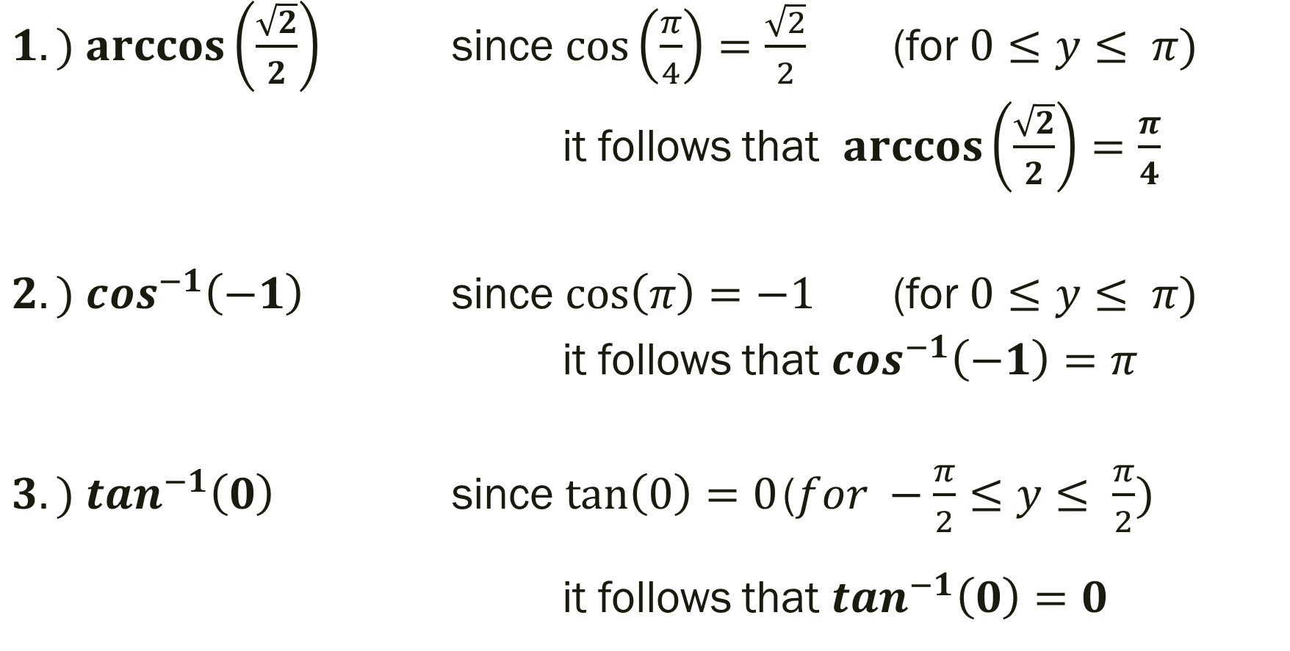
Examples: If possible, find the exact value.
$1.) arccos\left(\frac{\sqrt{2}}{2}\right)$ since $\cos\left(\frac{π}{4}\right)=\frac{\sqrt{2}}{2}$ (for $0≤y≤ π)$
it follows that $\arccos\left(\frac{\sqrt{2}}{2}\right)=\frac{π}{4}$
${2.) cos}^{−1}\left(−1\right)$ since $\cos\left(π\right)=−1$ (for $0≤y≤ π)$
it follows that $\cos^{−1}\left(−1\right)=π$
${3.) tan}^{−1}\left(0\right)$ since $\tan\left(0\right)=0$ ($for −\frac{π}{2}≤y≤ \frac{π}{2})$ it follows that $\tan^{−1}\left(0\right)=0$

Slide 22
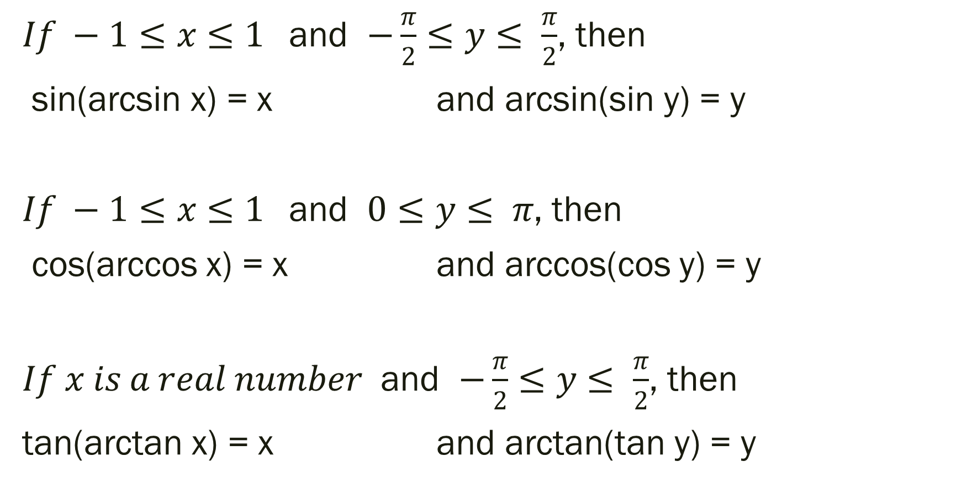
Inverse Properties of Trig Functions
$If −1≤x≤1$ and $−\frac{π}{2}≤y≤ \frac{π}{2}$, then
sin(arcsin x) = x and arcsin(sin y) = y
$If −1≤x≤1$ and $0≤y≤ π$, then
cos(arccos x) = x and arccos(cos y) = y
$If x is a real number$ and $−\frac{π}{2}≤y≤ \frac{π}{2}$, then
tan(arctan x) = x and arctan(tan y) = y

Slide 23
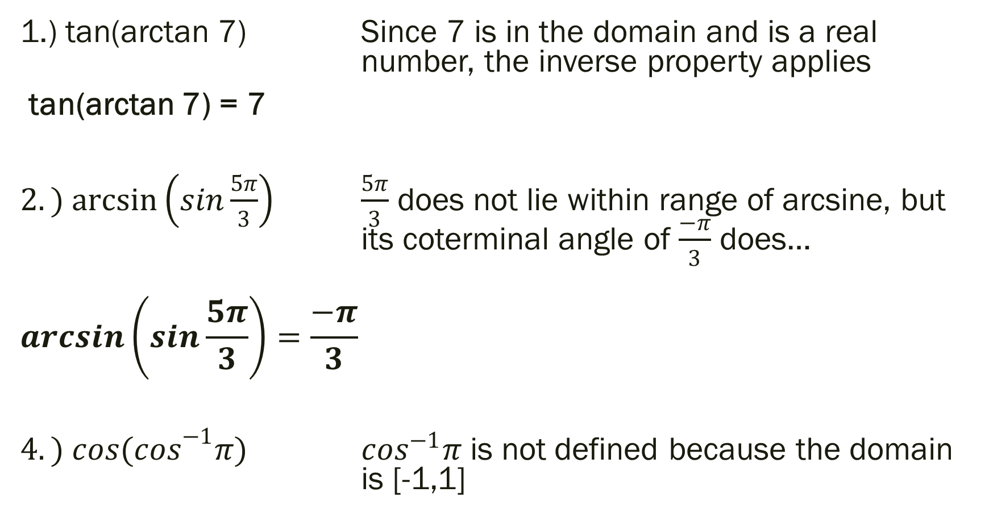
Examples: If possible, find the exact value.
1.) tan(arctan 7) Since 7 is in the domain and is a real number, the inverse property applies
tan(arctan 7) = 7
$2.) arcsin\left(sin\frac{5π}{3}\right)$ $\frac{5π}{3}$ does not lie within range of arcsine, but its coterminal angle of $\frac{−π}{3}$ does…
$$\arcsin\left(sin\frac{5π}{3}\right)=\frac{−π}{3}$$
$4.) {cos(cos}^{−1}π)$ $\cos^{−1}π$ is not defined because the domain is [-1,1]

Slide 24

Calculus Preview Examples:
Find the exact value.
$$1.) tan\left(arccos\frac{2}{3}\right)$$

Slide 25
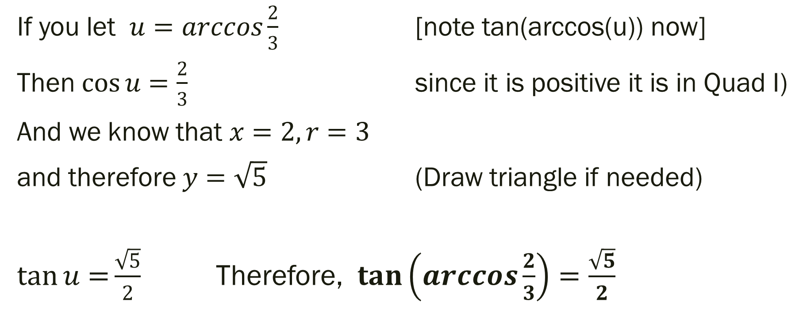
Solution
If you let $u=arccos\frac{2}{3}$ [note tan(arccos(u)) now]
Then $\cos{u}=\frac{2}{3}$ since it is positive it is in Quad I)
And we know that $x=2, r=3$
and therefore $y=\sqrt{5}$ (Draw triangle if needed)
$\tan{u=}\frac{\sqrt{5}}{2}$ Therefore, $\tan\left(arccos\frac{2}{3}\right)=\frac{\sqrt{5}}{2}$

Slide 26

Calculus Preview Examples:
Find the exact value.
$$2.) cos\left(\arcsin\left(\frac{−3}{5}\right)\right)$$

Slide 27
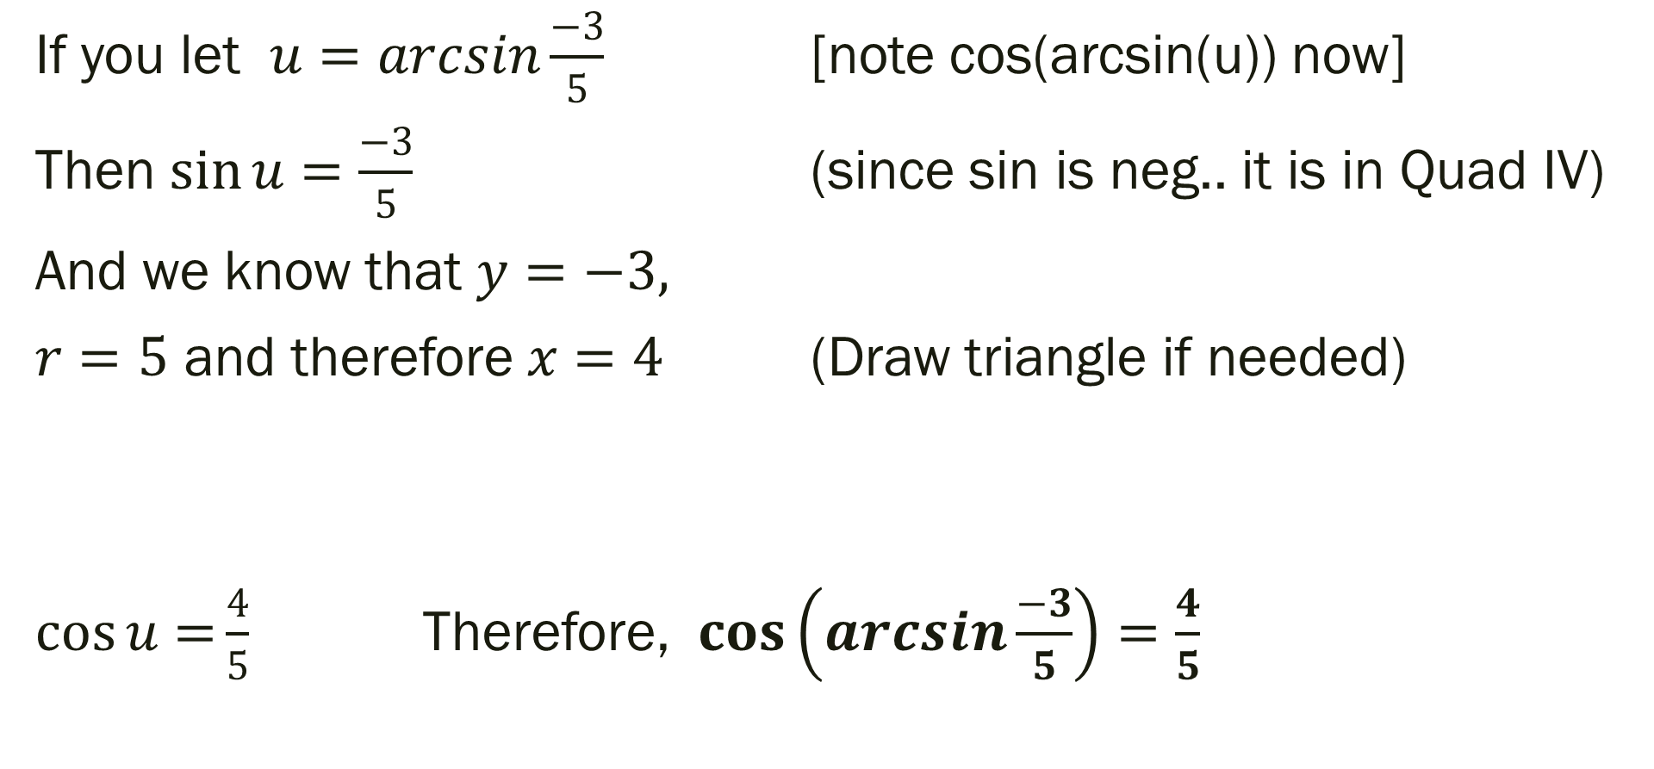
Solution
If you let $u=arcsin\frac{−3}{5}$ [note cos(arcsin(u)) now]
Then $\sin{u}=\frac{−3}{5}$ (since sin is neg.. it is in Quad IV)
And we know that $y=−3,$
$r=5$ and therefore $x=4$ (Draw triangle if needed)
$\cos{u=}\frac{4}{5}$ Therefore, $\cos\left(arcsin\frac{−3}{5}\right)=\frac{4}{5}$

Slide 28
For Next Time
Page 316 #9, 11, 13, 19-24, 37-44, 45-51 (odd), 69, 71, 97
Get a Head Start…
Page 347 #1-4, 5-9 (odd), 23-27 (odd), 43, 49-51, 55, 105, 111

